Slide 1
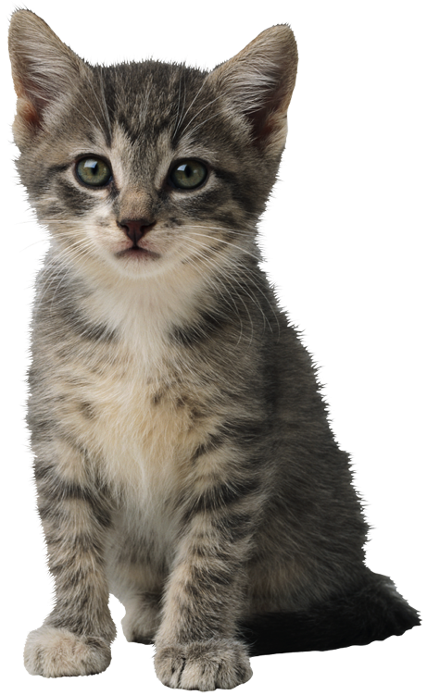
Irrational Agents
The Problem of Emotional Response

Slide 2
Rationality in Agents
Rationality is degree of reason an agent uses in its decisions.
A perfectly rational agent…
Assumes that its opponents are perfectly rational
Uses this assumption to make a prediction of behaviors
Makes a reasoned decision based on those predictions
Multiplayer games can be:
Symmetric (all players have the same abilities)
Assymetric (players have different abilities)

Slide 3

Rationality – The Pirate Game
Let’s consider rational agents in “The Pirate Game.”
There are 100 gold coins to be split.
The most senior pirate proposes a distribution.
All pirates vote on whether to accept (senior wins ties).
If the proposal is rejected, senior is thrown overboard.
All else being equal, pirates will opt to eliminate each other.
Until there is an agreement, continue voting.
Consider a game with five pirates, oldest to youngest:
Albert, Barry, Clyde, Doug, Evan.
At first, perhaps we think Albert should try to be equitable. However, this is not actually the most rational decision – it is an appeal to emotion (fairness).

Slide 4


Rationality – The Pirate Game
Instead, let’s work backwards, starting with just Doug and Evan.
Arr! Curse you, rationality!
Doug knows that he wins ties:
Pirate Gold Vote
Doug 100 Yes*
Evan 0 No
You’ll take one gold and like it!
What if we add Clyde?
Pirate Gold Vote
Clyde 99 Yes*
Doug 0 No
Evan 1 Yes
Let’s add in Barry…
Pirate Gold Vote
Barry 99 Yes*
Clyde 0 No
Doug 1 Yes
Evan 0 No
And finally, Albert:
Pirate Gold Vote
Albert 98 Yes*
Barry 0 No
Clyde 1 Yes
Doug 0 No
Evan 1 Yes

Slide 5
Depth of Rationality
We might be better served by estimating how far an agent will go to be rational.
Guess Two-Thirds Game
Get a group of people to choose a number, 0 to 100.
Winner is the one who is closest to two-thirds of average.
Agents also make decisions based on predictions of what other agents will do. Eventually most decisions will reach a Nash equilibrium.
Iteration 1 2 3 4 5 6 7 8 9 10 11
Value 66 44 29 19 13 9 6 4 2 1 0

Slide 6
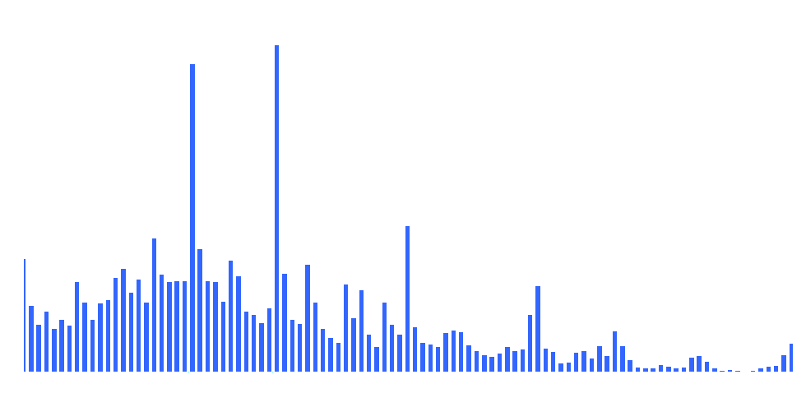

Decision Equilibrium
Eventually most decisions will reach a Nash equilibrium.
In the “Guess 2/3” game, the most common choices are 22 and 33.
Guess 2/3

Slide 7
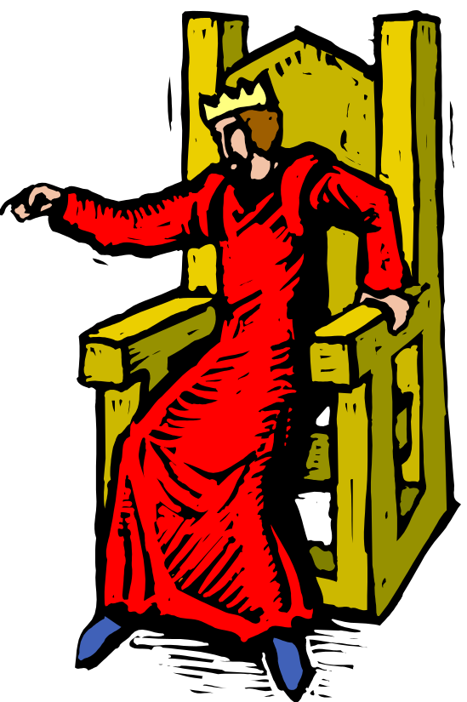
Rationality & Emotion
Many agents (especially humans) exhibit irrationality because they are influenced by emotion. They are often guided by trust and, when trust is violated, they often have a desire for revenge (tit-for-tat).
The Ultimatum Game – Greed vs. Fear
The Giver decides the split
The Decider accepts or rejects
If rejected, no one gets anything
The Dictator Game – Altruism
The Giver decides the split. The end.

Slide 8
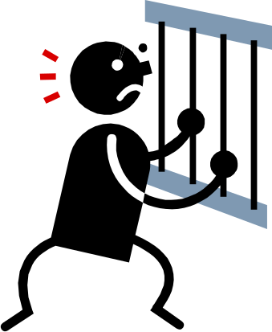
Rationality & Cooperation
Sometimes rationality makes everyone a loser.
Prisoner’s Dilemma
Two prisoners are suspected of a crime.
If both stay silent, both stay in jail for 6 months.
If one talks, he goes free and partner gets 10 years.
If both talk, each gets 5 years.
The strictly dominant strategy sucks – both get 5 years.

Slide 9
Artificial Emotion
By simulating emotion, we can make emotional levels another factor in the decision making process. This can affect the rationality of an agent, making it more “lifelike”.
In this model, emotion is broken into personality, mood, and feeling.

